Slide 1
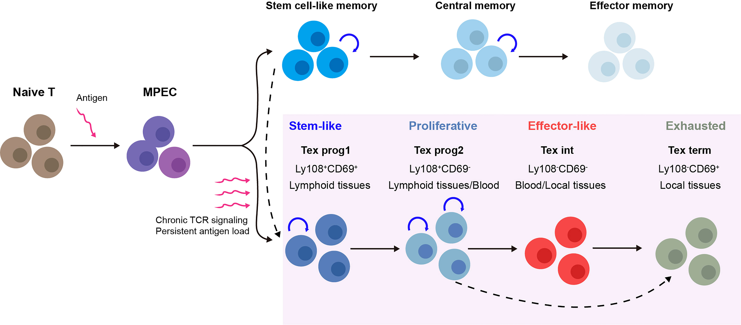
a
Acute response
Chronic response
Naive
Effector differentiation
Loss of maintenance potential
Central
memory
Progenitor
exhausted
Terminal
effector
Terminal
exhausted
b
Central memory
Effector memory
Terminal effector
Acute response
Ag
Ag
Naïve
T cell
CD62L+
KLRG1-
CD62L-
KLRG1-
CD62L-
KLRG1+
Ag
Progenitor
exhausted
Intermediate
exhausted
Terminal
exhausted
Chronic response
PD-1+
TCF1+
TIM3-
PD-1+
TCF1-
TIM3-
PD-1+
TCF1-
TIM3+

Slide 2
Elimination phase
Equilibrium phase
Escape phase
Suppressive
factors
Cytotoxic
activity
CD4
Treg
NKT
TAM
NK
CD8
Cytokine
CD4⁺
CD8
Inhibitory
ligands
Developing
tumour cell
Development of immunosuppressive
activity
Antigen-loss
variant

Slide 3
Thymus
Periphery
Foxp3
T_{reg} precursor
Thymic T_{reg}
Effector cells
Th1
Th2
Immune
activation
Th17
CD4– CD8–
(DN)
CD4⁺ CD8⁺
(DP)
Single-positive
precursor
Naïve
T cell
Foxp3
Peripheral T_{reg}

